Slide 1
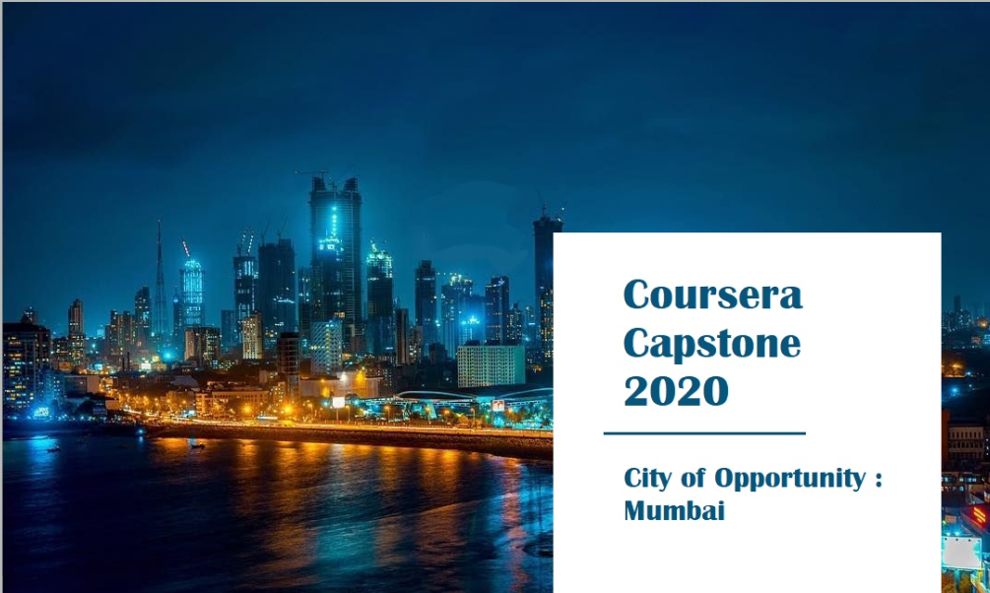
{

Slide 2

Introduction
 Mumbai is the commercial capital of India.
 Mumbai developed a highly diversified infrastructure.
 With its diverse society, comes diverse infrastructure which decides the quality of living.
 When one moves to a new city like Mumbai, is where to find a
good area to build and grow prosperously.
 The purpose is to help people in exploring better facilities around their neighborhood.

Slide 3

Business Problem
The questions I aim to answer in this project are the following:
List and visualize all major parts of Mumbai City with top existing infrastructure.
What are the best locations in Mumbai as per infrastructure?
Which areas have the potential for the development of infrastructure of different kinds?
Which all areas lack the infrastructure facilities?
What is the best place to stay within a city for all vital infrastructure facilities?

Slide 4


Data acquisition and cleaning
 For this project we need the following data:
Mumbai Pincode ( Scraped from web source)
Mumbai City data ( Geospace Data on Mumbai Pincode)
Different infrastructures in each neighborhood of Mumbai City data (Foursquare API)

Slide 5
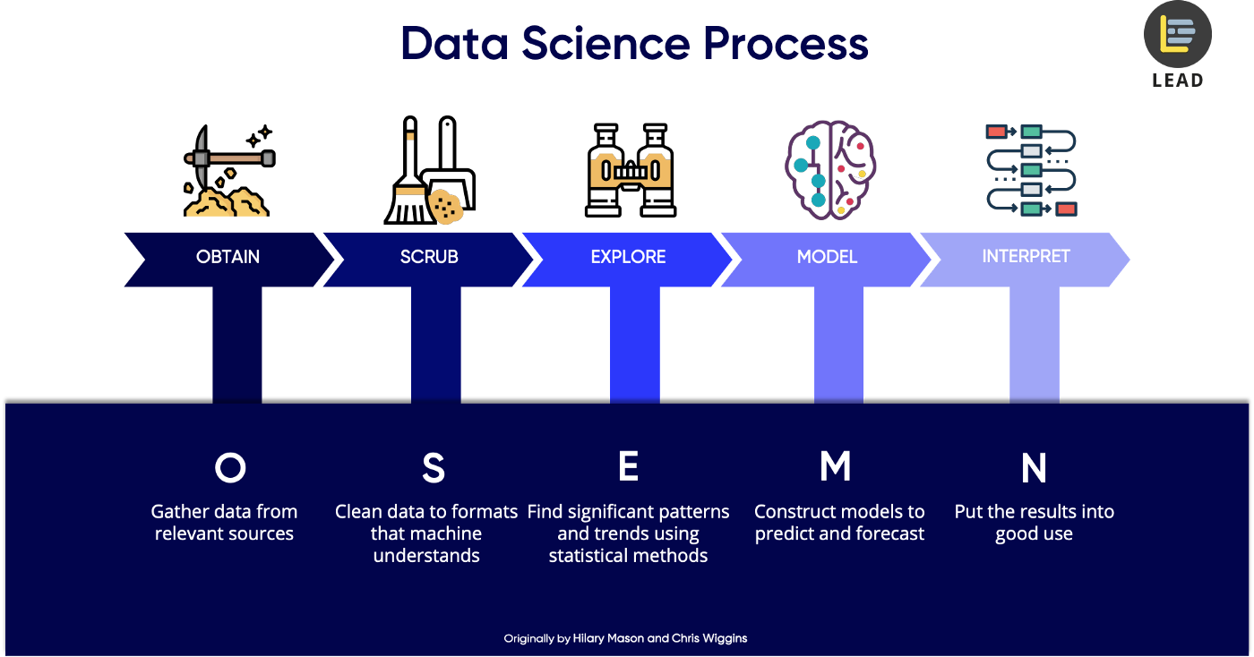
Methodology
Credit is provided below the image

Slide 6
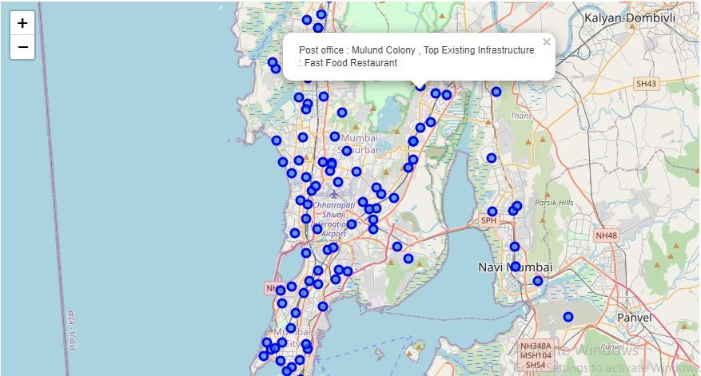
Results
1. Display the top existing infrastructure for each Postal Office in Mumbai.

Slide 7
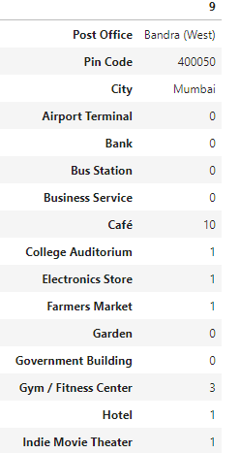
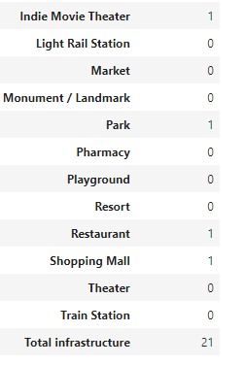
Results
2. What are the best locations in Mumbai as per infrastructure?

Slide 8
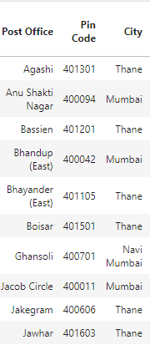
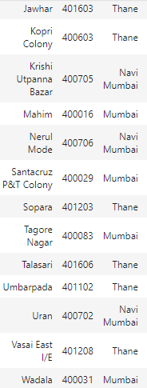
Results
3. Which all areas lack the infrastructure facilities?

Slide 9
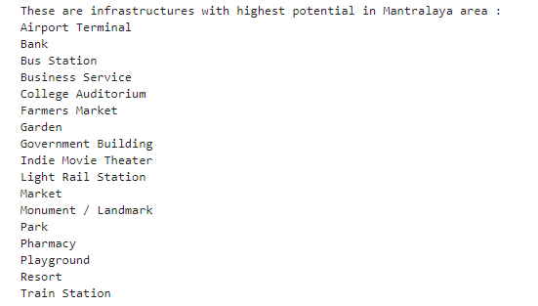
Results
4. Which of your choice areas have the potential for the development of infrastructure of different kinds?

Slide 10
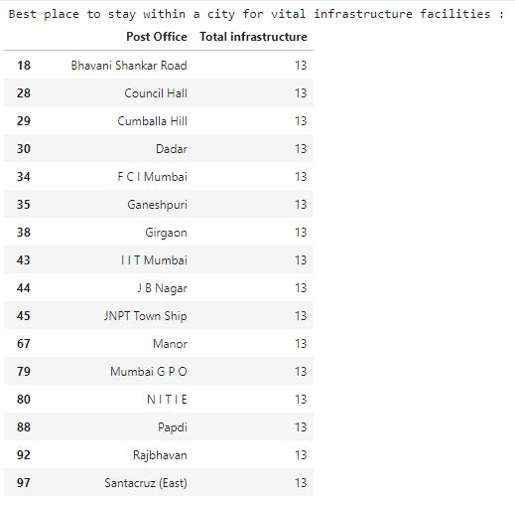
Results
5. What is the best place to stay within a city for all vital infrastructure facilities?

Slide 11
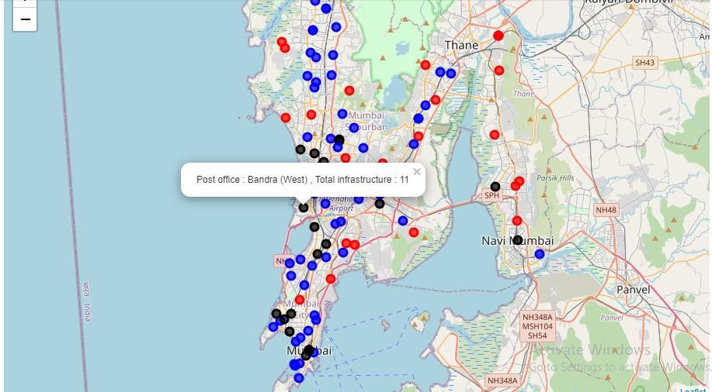
Clustering Based On Total Infrastructure
Cluster 1 (Red): Neighborhoods with a low number of infrastructures.
Cluster 0 (Black): Neighborhoods with a high number of infrastructures
Cluster 2 (Blue): Neighborhoods with a moderate number of infrastructures.

Slide 12

Discussion
 Bandra (West) is the best location in Mumbai as per infrastructure, with 10 Café boosting the number.
 19 postal offices are the best postal office area for essential variety
infrastructure.
 Most of the infrastructures are concentrated in the Southern areas of Mumbai city, with the highest number in cluster 0.

Slide 13
Recommendation
 Recommendation from Clustering :
 Cluster 1 with little to no competition - To open new infrastructures.
 Cluster 2 with moderate competition and supporting adequate no. of infrastructures – Ideal place to live prosperously and open unique infrastructures.
 Cluster 0 which already has a high concentration of infrastructures. – To settle in city and tough market to open new infrastructures.

Slide 14



Conclusion and future work
 This project made use of the free Sandbox Tier Account of Foursquare API - Limitations as to the number of API calls and results returned.
 Finding of these project will help relevant stakeholders i.e. business developers regarding the best locations to open a new infrastructure.
 The project also provides visitors and immigrants to the city regarding new postal office areas for growth and living prosperously.

Slide 15
THANK YOU!!

